Slide 1
CS4622 - Machine Learning Project
Group 09
Team Members:
140079K - S. O. A. D. Buddhika
140405J - N.M.S Nadeeshan
140345A - L.A.M.R.P.B Liyadipita
140699K - H. D. Witharana

Slide 2


Problem
The problem we are focusing is understanding voice commands without converting to text for a limited domain.
Eg: Domain: Bank
Utterances : What is my account balance?
What is the balance of my account?
Intent : Speaker needs to know the account balance.
Objective : Matching the both utterances to their intent .

Slide 3
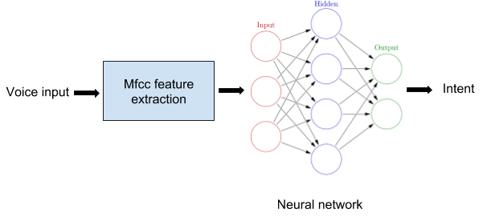
Methodology
We propose a machine learning approach to understand the intent
High level system architecture
Voice data

Slide 4
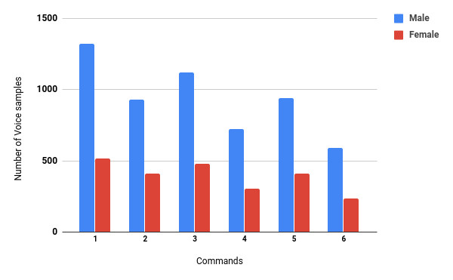
Data set
In the data set we have around 8460 speech clips for six commands in banking domain.
10 hours worth speech data was gathered from 215 speakers of which 152 were male and 63 were female.
Six basic commands
Deposit money
Withdraw money
Transfer money between accounts
Bill payments
Credit card payments
Account balance
.

Slide 5
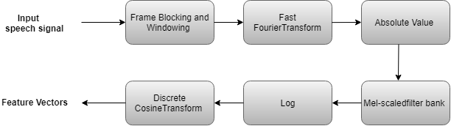
Feature Extraction - Methodology
We considered MFCC technology for feature extraction.

Slide 6
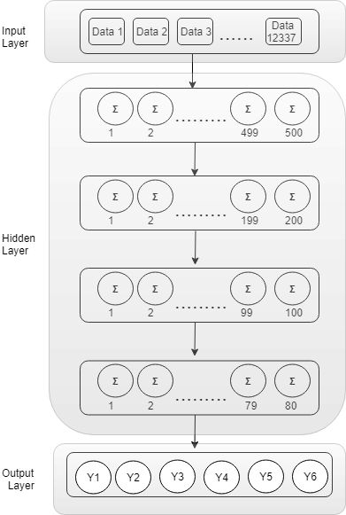
Neural Network Model
The multilayer neural network with back-propagation technique is used.
The structure of the neural network include input layer, four hidden layers and output layer.
The number of nodes in each hidden layer are 500, 200, 100 and 80 respectively.
Relu is used as hidden layer activation function
Softmax is used as the output layer activation function.

Slide 7
Thank You

